Slide 1
Wintersemester 2017
Network Motif:
Simulation of Feed-Forward Loop
Sina Bayer, Lisa De Mont
Supervisor: Björn Goldenbogen
Humboldt-Universität zu Berlin Institut für Biologie Theoretische Biophysik

Slide 2
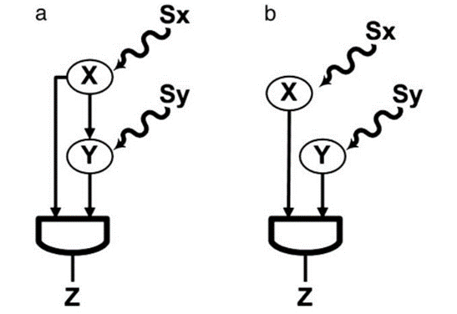


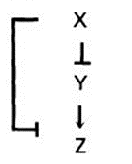
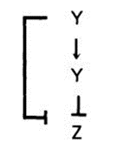


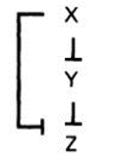
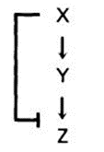

FFL vs. Simple regulation
8 Types of FFl
Coherent
Incoherent
Type 1
Type 2
Type 3
Type 4
Type 1
Type 2
Type 3
Type 4
All Pictures from: Mangan, Alon: Structure and function of the feed-forward loop network motif

Slide 3
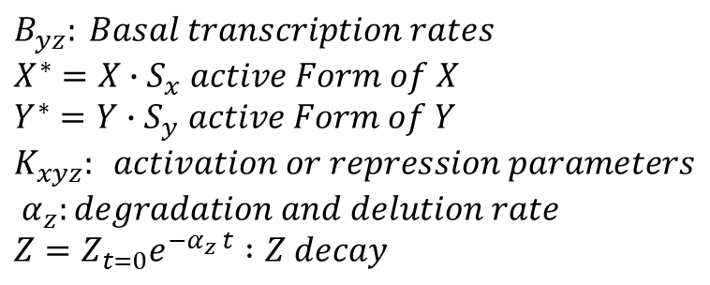
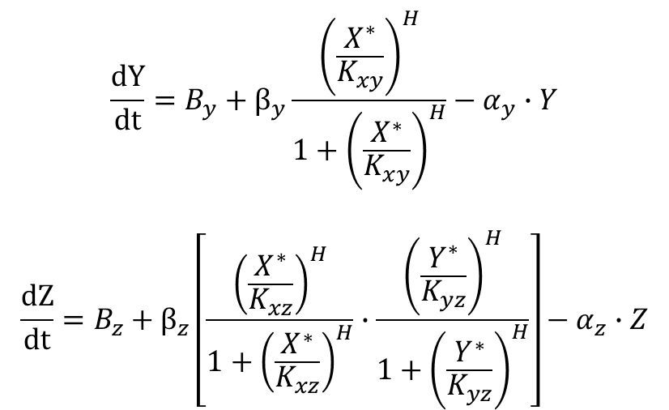
Example For Coherent Type 1 AND
$$\frac{dY}{dt}=B_{y}+β_{y}\frac{{\left(\frac{X^{∗}}{K_{xy}}\right)}^{H}}{1+{\left(\frac{X^{∗}}{K_{xy}}\right)}^{H}}−α_{y}∙Y$$
$$\frac{dZ}{dt}=B_{z}+β_{z}\left[\frac{{\left(\frac{X^{∗}}{K_{xz}}\right)}^{H}}{1+{\left(\frac{X^{∗}}{K_{xz}}\right)}^{H}}∙\frac{{\left(\frac{Y^{∗}}{K_{yz}}\right)}^{H}}{1+{\left(\frac{Y^{∗}}{K_{yz}}\right)}^{H}}\right]−α_{z}∙Z$$
$$B_{yz}: Basal transcription rates \\ X^{∗}=X∙S_{x} active Form of X \\ Y^{∗}=Y∙S_{y} active Form of Y \\ K_{xyz}: activation or repression parameters \\ α_{z}:degradation and delution rate \\ Z=Z_{t=0}e^{−α_{z} t} :Z decay$$

Slide 4
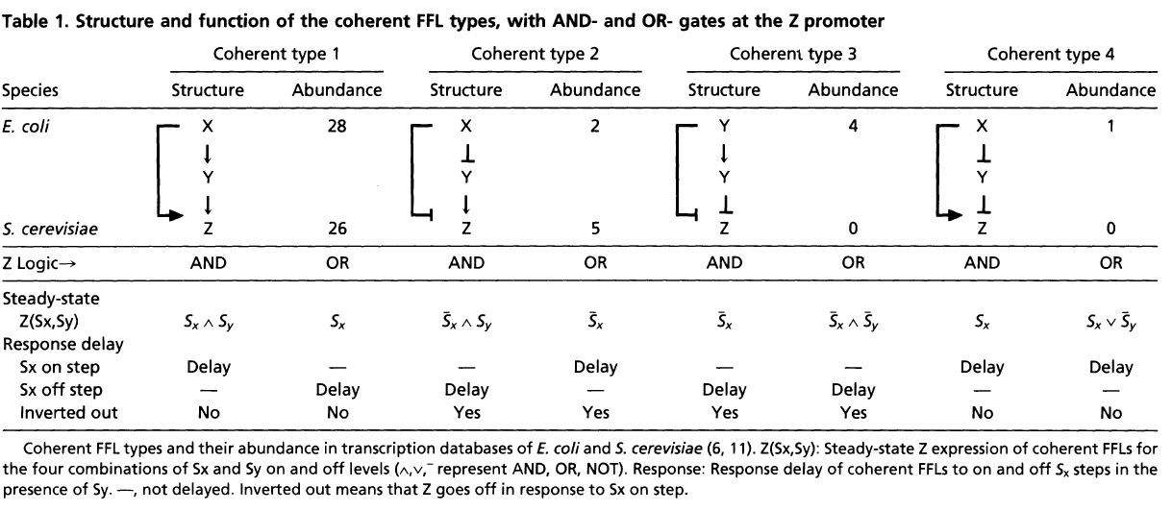

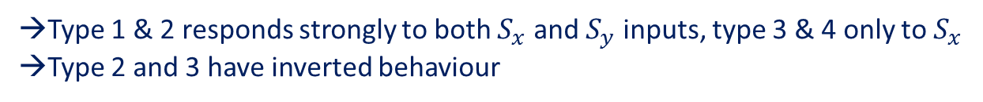
Coherent FFL
→Type 1 & 2 responds strongly to both $S_{x}$ and $S_{y}$ inputs, type 3 & 4 only to $S_{x}$
→Type 2 and 3 have inverted behaviour
Table 1: Mangan, Alon: Structure and function of the feed-forward loop network motif

Slide 5
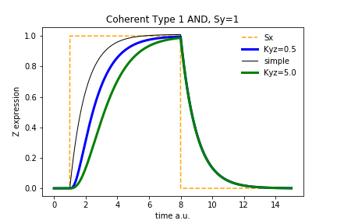
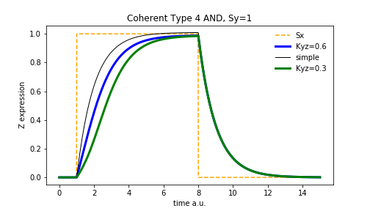
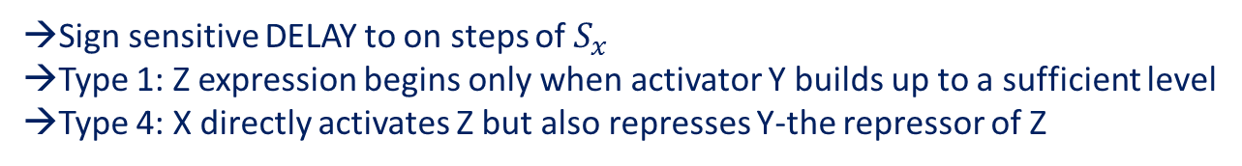
Coherent Type 1
Coherent Type 4
→Sign sensitive DELAY to on steps of $S_{x}$
→Type 1: Z expression begins only when activator Y builds up to a sufficient level
→Type 4: X directly activates Z but also represses Y-the repressor of Z

Slide 6
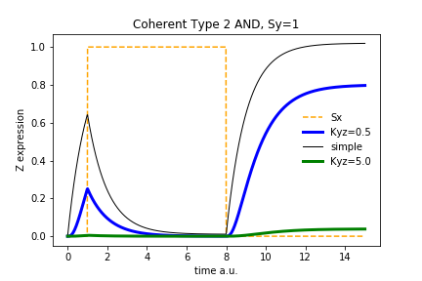
Coherent Type 2
→Inverted behaviour to Coherent Type 1: Z goes off in response to $S_{x}$ on step

Slide 7
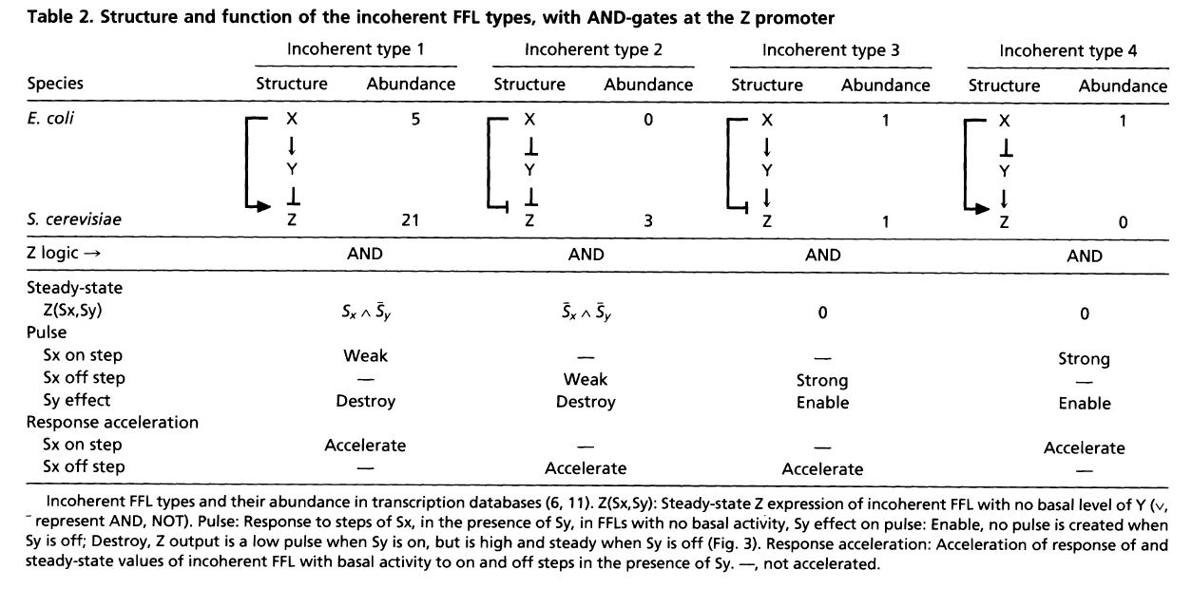
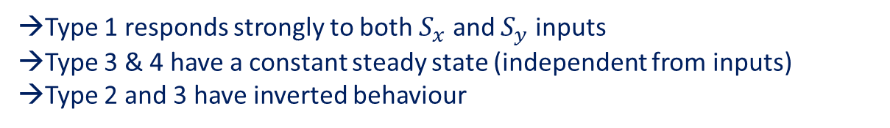
Incoherent FFL
→Type 1 responds strongly to both $S_{x}$ and $S_{y}$ inputs
→Type 3 & 4 have a constant steady state (independent from inputs)
→Type 2 and 3 have inverted behaviour
Table 2: Mangan, Alon: Structure and function of the feed-forward loop network motif

Slide 8
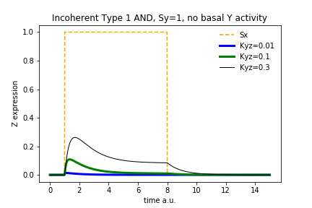
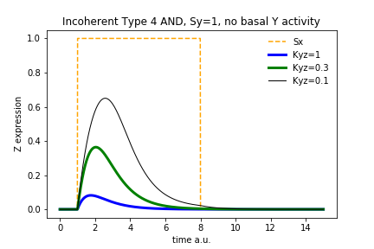
Incoherent Type 1
Incoherent Type 4
→Incoherent FFL act as PULSERS with no basal Y activity →Type 4: Y production is repressed by X and Z production decreases after rise

Slide 9
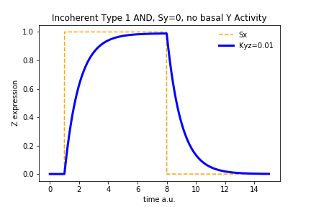
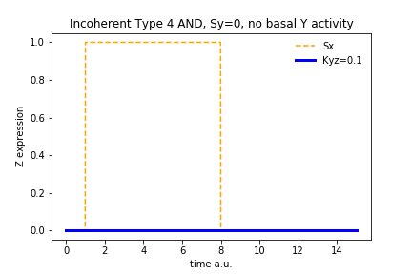
Incoherent Type 1
Incoherent Type 4
→Type 1: lost pulse like nature
→Type 4: pulse enabled by $S_{y}$ activation (AND gate only)

Slide 10
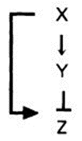
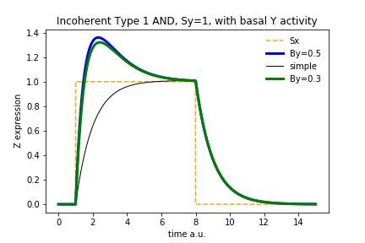
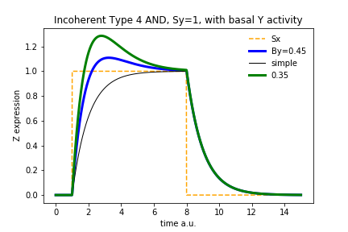
Incoherent Type 1
Incoherent Type 4
With basal Y activity
Acceleration

Slide 11
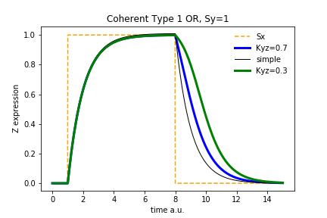
Coherent Type 1 AND
Coherent Type 1
OR
Delay on on-step
Delay on off-step
reverse sign-sensitivity

Slide 12
Conclusion
Delay: - coherent FFLs
- persistence detectors
Pulse: - some incoherent FFLs
Acceleration: - some incoherent FFLs
- with basal Y-activity
Reverse sign-sensitivity (on/off-step):
- OR-Gate

Slide 13
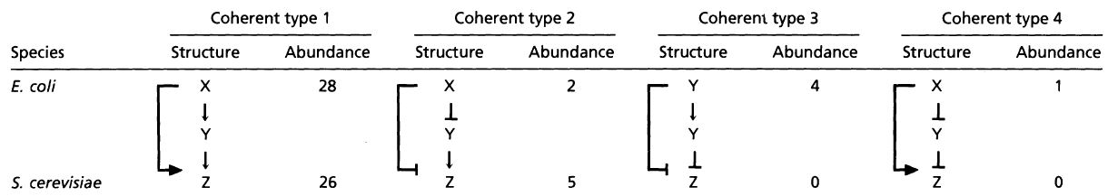
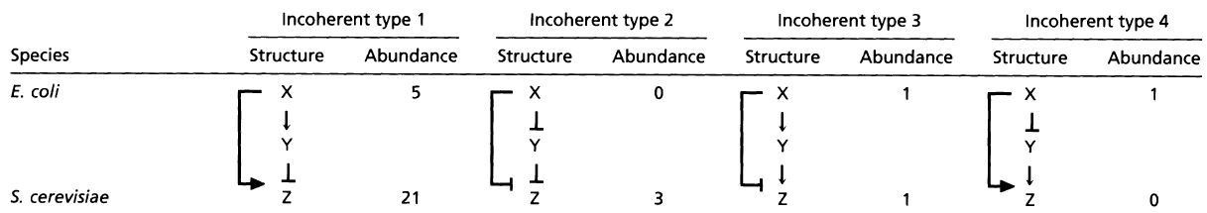
Occurence in E. coli and Yeast
Mangan, Alon: Structure and function of the feed-forward loop network motif
Notes:
Vorund nachteile vom paper
Allgemeine Aussage
Andere Motive network

Slide 14
Additions
Normalization to steady-states?
Other types: 2 and 3?
Comparison to other motifs?

Slide 15
Thank you for your attention!

Slide 16
Sources
‘’Structure and function of the feed-forward loop network motif’’
S. Mangan and U. Alon†
Departments of Molecular Cell Biology and Physics of Complex Systems, Weizmann Institute of Science, Rehovot 76100, Israel

